Slide 1
Unit V: Data Mining
Cluster Analysis: Basic Concepts and Algorithms

Slide 2
What is Cluster Analysis?
Finding groups of objects such that the objects in a group will be similar (or related) to one another and different from (or unrelated to) the objects in other groups
Inter-cluster distances are maximized
Intra-cluster distances are minimized

Slide 3
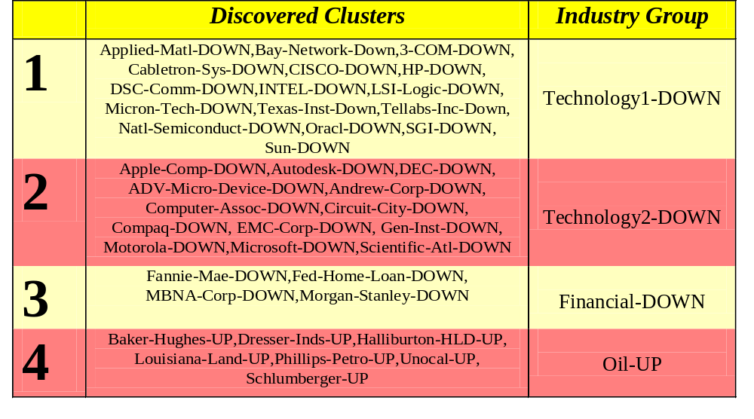
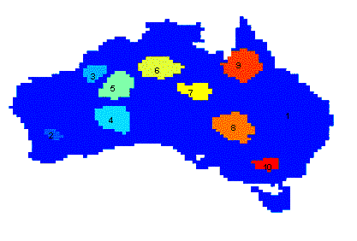
Applications of Cluster Analysis
Understanding
  Group related documents for browsing, group genes and proteins that have similar functionality, or group stocks with similar price fluctuations
Summarization
  Reduce the size of large data sets
Clustering precipitation in Australia

Slide 4
What is not Cluster Analysis?
Supervised classification
  Have class label information
Simple segmentation
  Dividing students into different registration groups alphabetically, by last name
Results of a query
  Groupings are a result of an external specification
Graph partitioning
  Some mutual relevance and synergy, but areas are not identical

Slide 5
Notion of a Cluster can be Ambiguous
How many clusters?
Six Clusters
Two Clusters
Four Clusters

Slide 6
Types of Clusterings
A clustering is a set of clusters
Important distinction between hierarchical and partitional sets of clusters
Partitional Clustering
  A division data objects into non-overlapping subsets (clusters) such that each data object is in exactly one subset
Hierarchical clustering
  A set of nested clusters organized as a hierarchical tree

Slide 7

Partitional Clustering
Original Points
A Partitional Clustering

Slide 8
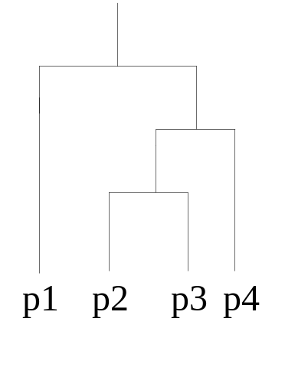
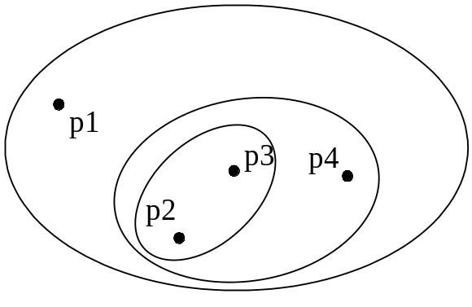
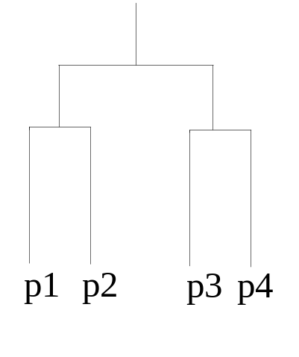
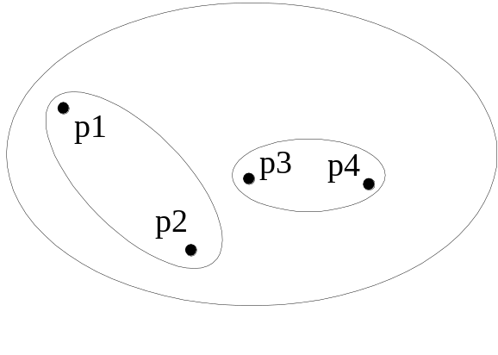
Hierarchical Clustering
Traditional Hierarchical Clustering
Traditional Dendrogram
Non-traditional Hierarchical Clustering
Non-traditional Dendrogram

Slide 9
Types of Clusters
Well-separated clusters
Center-based clusters
Contiguous clusters
Density-based clusters
Property or Conceptual
Described by an Objective Function

Slide 10
Types of Clusters: Well-Separated
Well-Separated Clusters:
  A cluster is a set of points such that any point in a cluster is closer (or more similar) to every other point in the cluster than to any point not in the cluster.
3 well-separated clusters

Slide 11
Types of Clusters: Center-Based
Center-based
  A cluster is a set of objects such that an object in a cluster is closer (more similar) to the “center” of a cluster, than to the center of any other cluster
  The center of a cluster is often a centroid, the average of all the points in the cluster, or a medoid, the most “representative” point of a cluster
4 center-based clusters

Slide 12
Types of Clusters: Contiguity-Based
Contiguous Cluster (Nearest neighbor or Transitive)
  A cluster is a set of points such that a point in a cluster is closer (or more similar) to one or more other points in the cluster than to any point not in the cluster.
8 contiguous clusters

Slide 13
Types of Clusters: Density-Based
Density-based
  A cluster is a dense region of points, which is separated by low-density regions, from other regions of high density.
  Used when the clusters are irregular or intertwined, and when noise and outliers are present.
6 density-based clusters

Slide 14
Types of Clusters: Conceptual Clusters
Shared Property or Conceptual Clusters
  Finds clusters that share some common property or represent a particular concept.
  .
2 Overlapping Circles

Slide 15
Types of Clusters: Objective Function
Clusters Defined by an Objective Function
  Finds clusters that minimize or maximize an objective function.
  Enumerate all possible ways of dividing the points into clusters and evaluate the `goodness' of each potential set of clusters by using the given objective function. (NP Hard)
  Can have global or local objectives.
    Hierarchical clustering algorithms typically have local objectives
    Partitional algorithms typically have global objectives
  A variation of the global objective function approach is to fit the data to a parameterized model.
    Parameters for the model are determined from the data.
    Mixture models assume that the data is a ‘mixture' of a number of statistical distributions.

Slide 16
Types of Clusters: Objective Function …
Map the clustering problem to a different domain and solve a related problem in that domain
  Proximity matrix defines a weighted graph, where the nodes are the points being clustered, and the weighted edges represent the proximities between points
  Clustering is equivalent to breaking the graph into connected components, one for each cluster.
  Want to minimize the edge weight between clusters and maximize the edge weight within clusters

Slide 17
Characteristics of the Input Data Are Important
Type of proximity or density measure
  This is a derived measure, but central to clustering
Sparseness
  Dictates type of similarity
  Adds to efficiency
Attribute type
  Dictates type of similarity
Type of Data
  Dictates type of similarity
  Other characteristics, e.g., autocorrelation
Dimensionality
Noise and Outliers
Type of Distribution

Slide 18
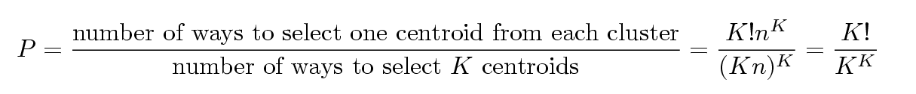
Problems with Selecting Initial Points
If there are K ‘real’ clusters then the chance of selecting one centroid from each cluster is small.
  Chance is relatively small when K is large
  If clusters are the same size, n, then
  For example, if K = 10, then probability = 10!/10¹⁰ = 0.00036
  Sometimes the initial centroids will readjust themselves in ‘right’ way, and sometimes they don’t
  Consider an example of five pairs of clusters

Slide 19
Solutions to Initial Centroids Problem
Multiple runs
  Helps, but probability is not on your side
Sample and use hierarchical clustering to determine initial centroids
Select more than k initial centroids and then select among these initial centroids
  Select most widely separated
Postprocessing
Bisecting K-means
  Not as susceptible to initialization issues

Slide 20
Handling Empty Clusters
Basic K-means algorithm can yield empty clusters
Several strategies
  Choose the point that contributes most to SSE
  Choose a point from the cluster with the highest SSE
  If there are several empty clusters, the above can be repeated several times.

Slide 21
Updating Centers Incrementally
In the basic K-means algorithm, centroids are updated after all points are assigned to a centroid
An alternative is to update the centroids after each assignment (incremental approach)
  Each assignment updates zero or two centroids
  More expensive
  Introduces an order dependency
  Never get an empty cluster
  Can use “weights” to change the impact

Slide 22
Pre-processing and Post-processing
Pre-processing
  Normalize the data
  Eliminate outliers
Post-processing
  Eliminate small clusters that may represent outliers
  Split ‘loose’ clusters, i.e., clusters with relatively high SSE
  Merge clusters that are ‘close’ and that have relatively low SSE
  Can use these steps during the clustering process
    ISODATA

Slide 23

Bisecting K-means
Bisecting K-means algorithm
  Variant of K-means that can produce a partitional or a hierarchical clustering

Slide 24
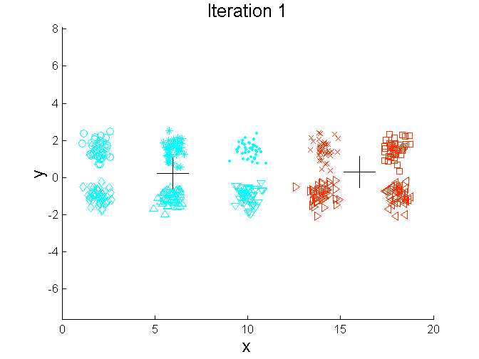
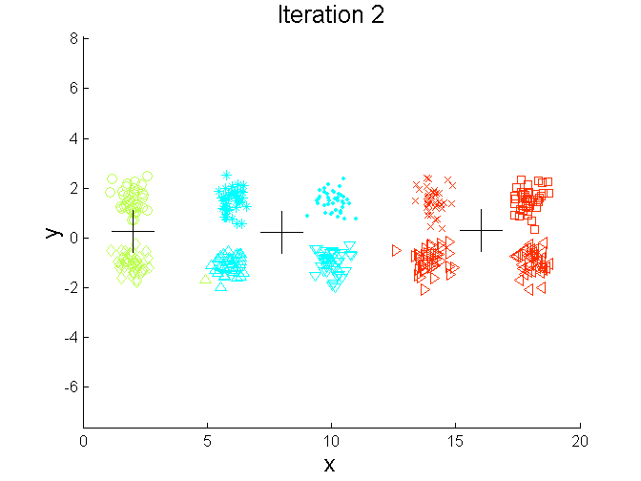
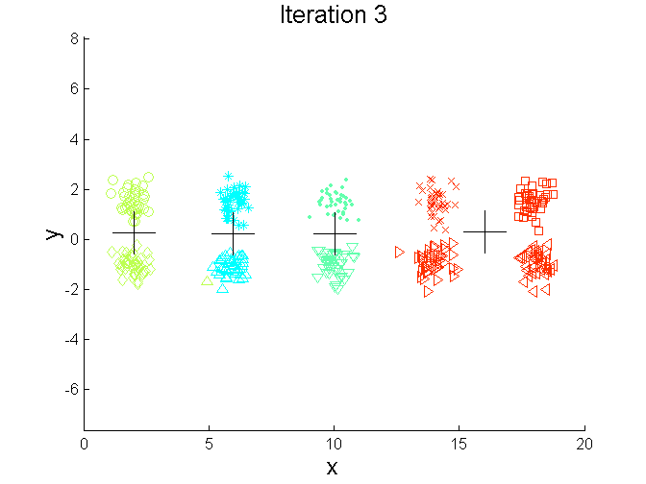
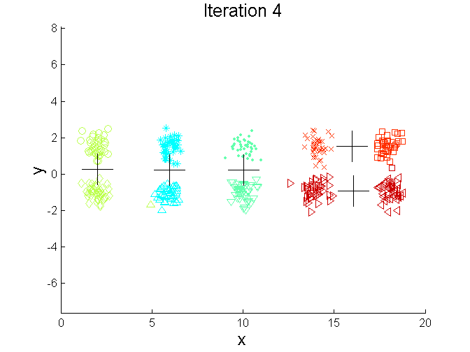
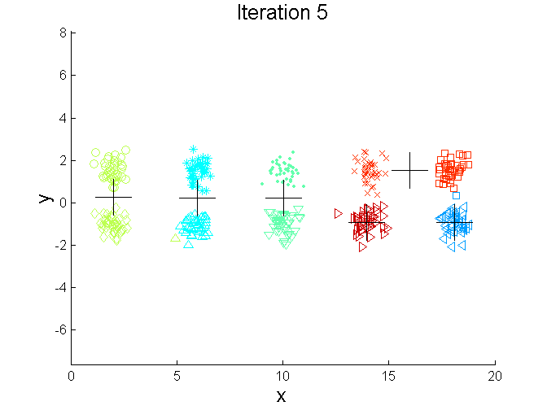
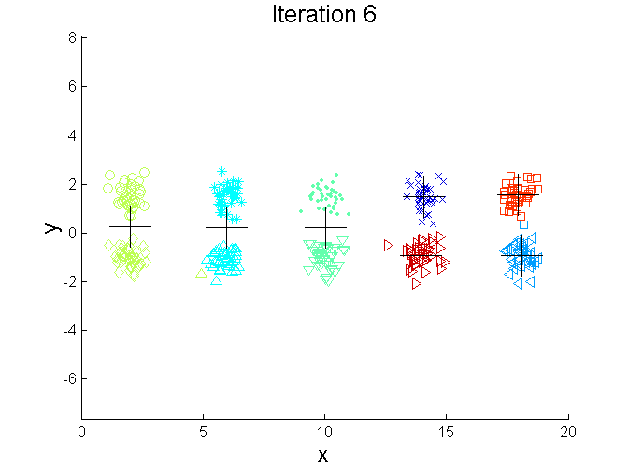
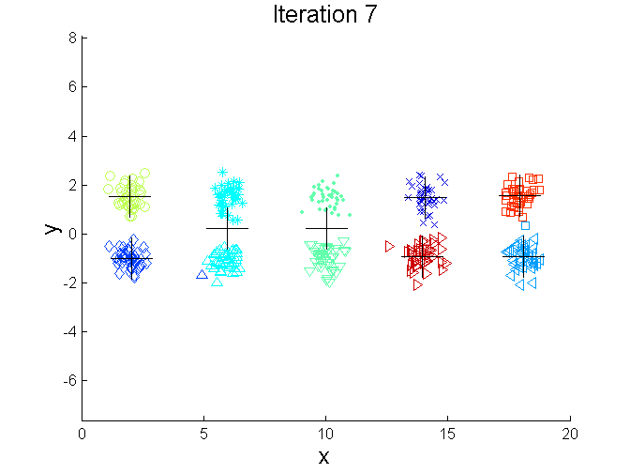
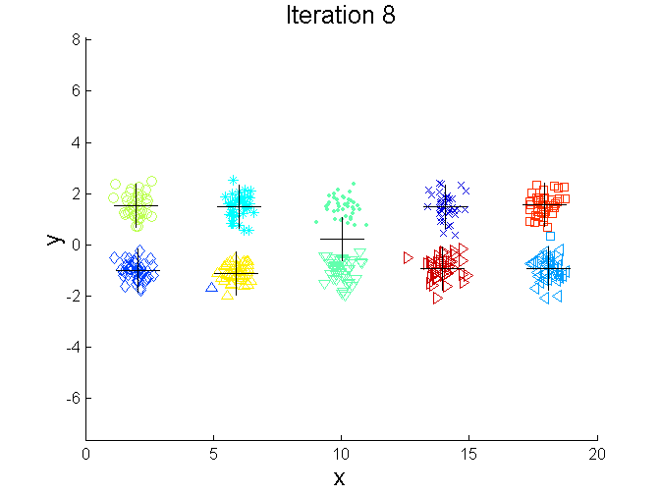
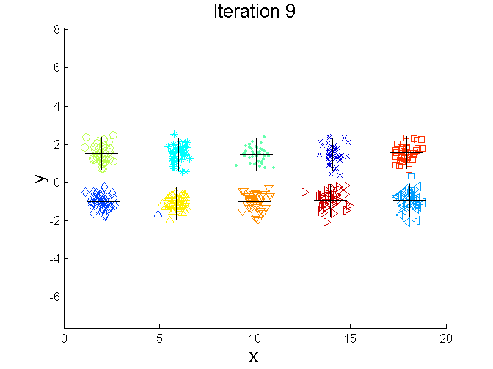
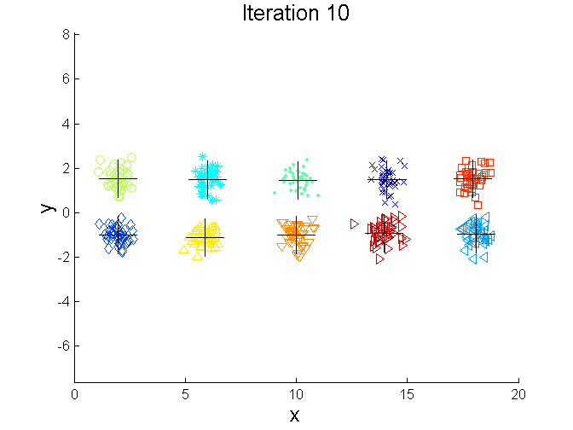
Bisecting K-means Example

Slide 25
Limitations of K-means
K-means has problems when clusters are of differing
  Sizes
  Densities
  Non-globular shapes
K-means has problems when the data contains outliers.

Slide 26


Limitations of K-means: Differing Sizes
Original Points
K-means (3 Clusters)

Slide 27


Limitations of K-means: Differing Density
Original Points
K-means (3 Clusters)

Slide 28


Limitations of K-means: Non-globular Shapes
Original Points
K-means (2 Clusters)

Slide 29

Overcoming K-means Limitations
Original Points K-means Clusters
One solution is to use many clusters.
  Find parts of clusters, but need to put together.

Slide 30
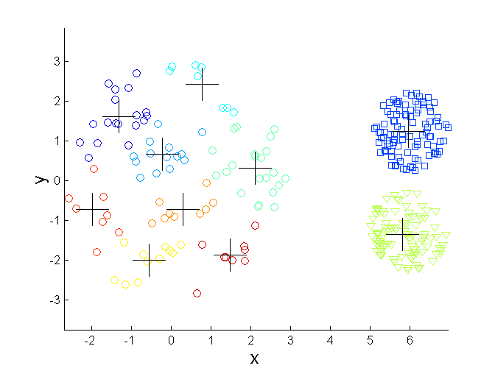
Overcoming K-means Limitations
Original Points K-means Clusters

Slide 31
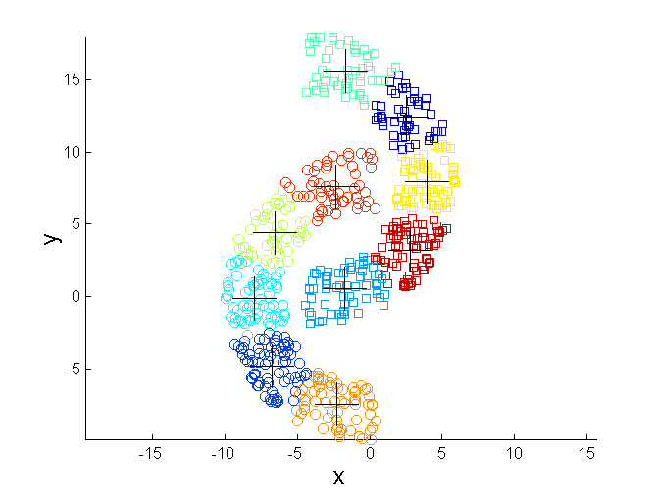
Overcoming K-means Limitations
Original Points K-means Clusters

Slide 32
Final Comment on Cluster Validity
“The validation of clustering structures is the most difficult and frustrating part of cluster analysis.
Without a strong effort in this direction, cluster analysis will remain a black art accessible only to those true believers who have experience and great courage.”
Algorithms for Clustering Data, Jain and Dubes

